Slide 1
BORN TO CODE
TEAM MEMBER :
1. SAHIL SINGH
2. SUMIT KUMAR

Slide 2
WATER LEVEL ALERT SYSTEM
COMPONENTS USED :
1. BC 547 TRANSISTOR
2. 1 K RESISTANCE
3. ZERO PCB
4. LED”S
5. BUZZER

Slide 3
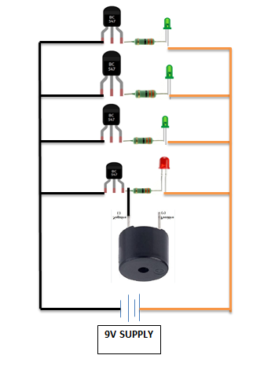
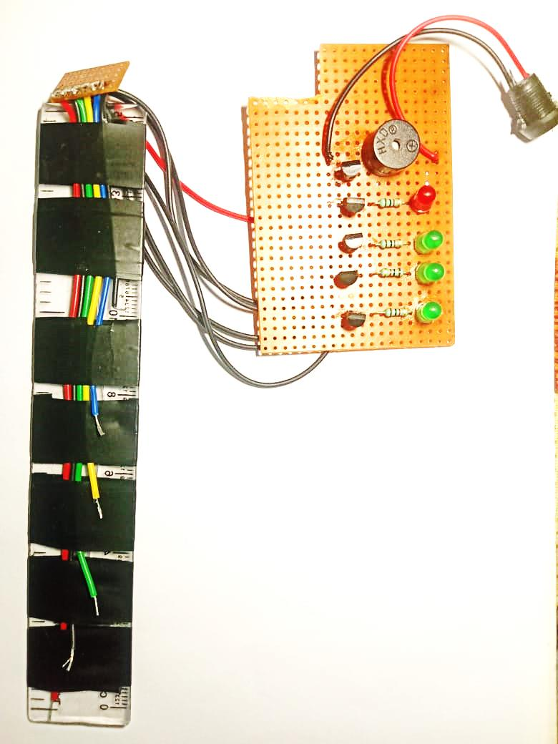
CIRCUIT DIAGRAM
PROJECT AFTER ASSEMBLING

Slide 4
# .Working of this project :-
In this project positive terminal of all the led and buzzer are connected to the positive terminal of 9v power supply and the negative terminal of all the led and buzzer are connected to collector of transistor via 1 k resistance and the negative terminal of power supply is connected to emitter of transistor at last the wires for indicating water level and overflow alarm are connected to base of the transistor.
In this system the transistor increase the conductivity in water therefore the circuit get completed and the buzzer and led turn on.

